Slide 1
E-Campus
Presented by Team 1234:
Bryan Dong, Sushanta Sapkota, Joseph Helfenbein, Pragyam Tiwari, Sajid Patwary, Tanvir
On November 3, 2025

Slide 2



What, Who, How and Why
Allow for campus events to be scheduled with tickets that are bought to attend.
Organizations want to create events and sell tickets.
Students want to go to events.
Colleges benefit from a single platform for all events.
Data about size of active student body and types of events at a campus helps companies advertise better.

Slide 3

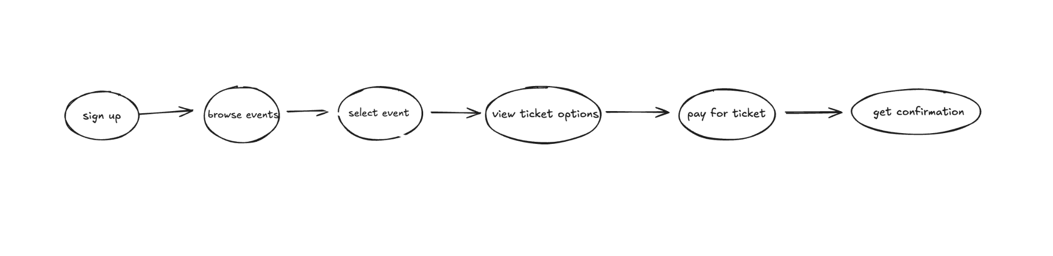
USERS journey

Slide 4
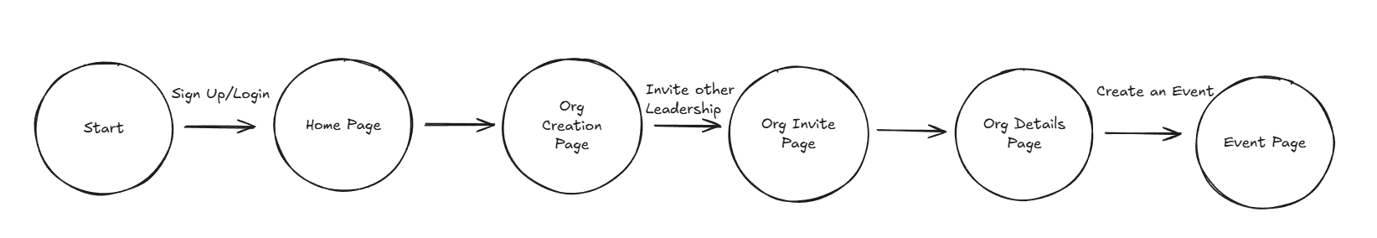
Organization Admin Journey

Slide 5

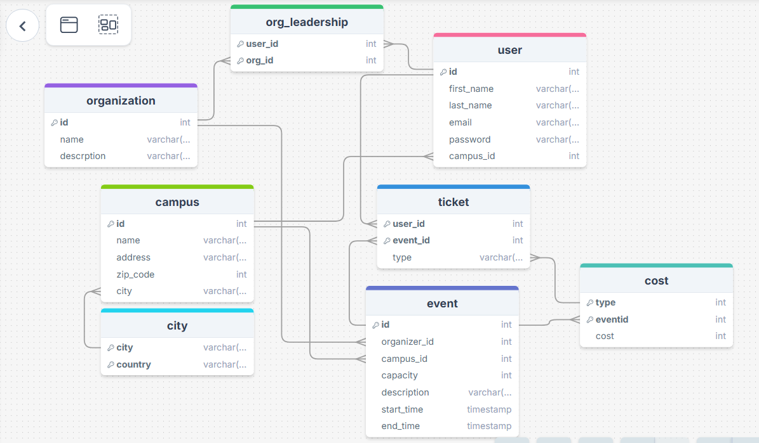
Our Database Design

Slide 6
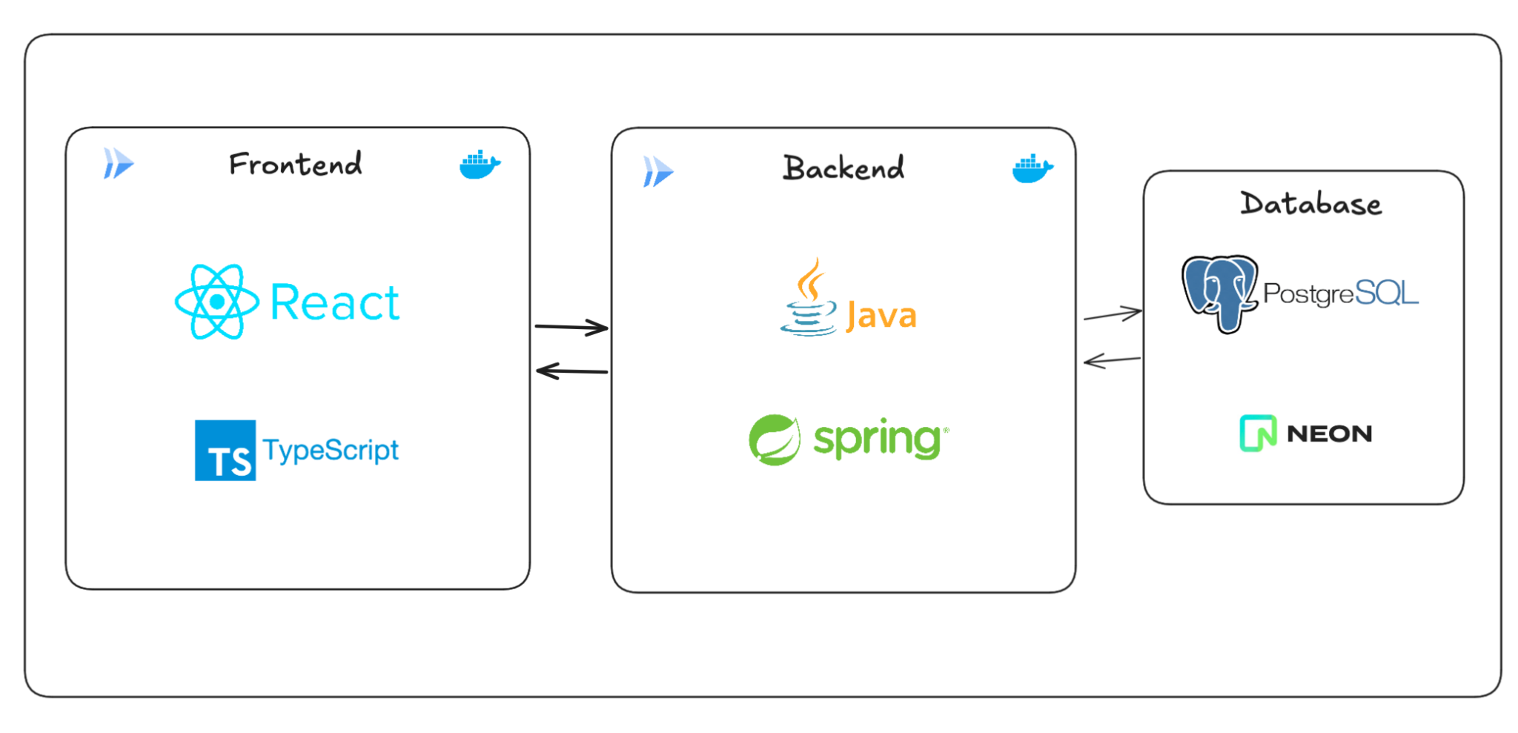
The Stack

Slide 7
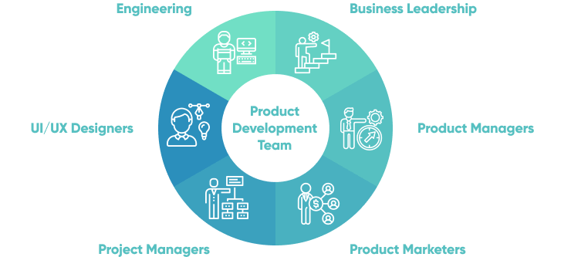
Member Roles
Bryan - backend and database management
Sushanta - frontend developer and database
Joseph - cloud deployment and backend
Pragyam - backend and frontend developer
Sajid - front end development and database management
Tanvir - General developer

Slide 8
Q&A

